Slide 1
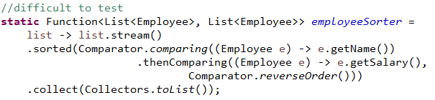
W4D1: Unit-Testing Stream Pipelines:
ComplexExpressions
Example: Sorts Employees first by name (ascending), then by salary in descending order
The key point to test is whether any two Employees are being compared in the correct way.
This can be done by replacing the lambda expression that defines the Comparator with a method reference, together with an auxiliary method that can be placed in a companion class LibraryCompanion.
Demo: lesson10.lecture.libcompanion

Slide 2
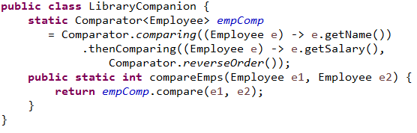
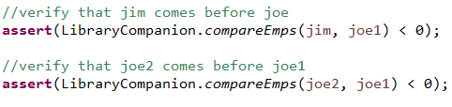
//auxiliary method, used in method reference, in the class LibraryCompanion
Strategy: Refactor the pipeline using auxiliary methods that can be tested separately. (See next slide also!)
static Function<List<Employee>, List<Employee>> employeeSorter =
list -> list.stream()
.sorted(LibraryCompanion::compareEmps)
.collect(Collectors.toList());
Now the key element of the original lambda can be tested directly:

Slide 3
W4D1: Unit-Testing Stream Pipelines:
ComplexExpressions
The previous slide should have joe1 first I believe (JL).
We also need to call the method with joe1 and joe1, to make sure that the ‘thenComparing’ is working properly.

Slide 4
W4D1: Unit-Testing Stream Pipelines:
ComplexExpressions
The example suggests a best practice for unit testing when lambdas are involved:
Replace a lambda that needs to be tested with a method reference plus an auxiliary method
Then you can test the auxiliary method
(Back to the word document)

Slide 5
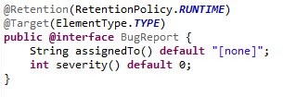
W2D4 : What Are Annotations?
User-defined annotations. The @interface keyword is the way the Java compiler knows you are creating an annotation; such “classes” extend the Annotation interface. See the demo lesson10.lecture.annotation
Note: The code shows how the elements "assigned to" and "severity"
are defined.
Note: Both of the above(RetentionPolicy and ElementType) are Oracle Java Enum.

Slide 6
Annotation Reference
@Retention @Retention annotation specifies how the marked annotation is stored:
  RetentionPolicy.SOURCE – The marked annotation is retained only in the source level and is ignored by the compiler.
  RetentionPolicy.CLASS – The marked annotation is retained by the compiler at compile time, but is ignored by the Java Virtual Machine (JVM).
  RetentionPolicy.RUNTIME – The marked annotation is retained by the JVM so it can be used by the runtime environment.
@Target @Target annotation marks another annotation to restrict what kind of Java elements the annotation can be applied to. A target annotation specifies one of the following element types as its value:
  ElementType.ANNOTATION_TYPE can be applied to an annotation type.
  ElementType.CONSTRUCTOR can be applied to a constructor.
  ElementType.FIELD can be applied to a field or property.
  ElementType.LOCAL_VARIABLE can be applied to a local variable.
  ElementType.METHOD can be applied to a method-level annotation.
  ElementType.PACKAGE can be applied to a package declaration.
  ElementType.PARAMETER can be applied to the parameters of a method.
  ElementType.TYPE can be applied to any element of a class.

Slide 7
W2D4 : Handling Exceptions with Try-with-Resources
You Wish to Use Resources Carefully. When your application uses external resources, like files or a database connection, it is important to close the connections after your application has finished using them. Typically, using these connections involves checked exceptions; but whether or not an exception is thrown, your application must disconnect from the resource, or there can be a memory leak, causing memory to fill up.
Do clean-up in a finally block. The usual way to clean up resources is in a finally block, which will execute whether or not an exception is thrown.
Complication. But, what if closing a resource is also capable of throwing a checked exception? How should this be handled?
  Demo: lesson10.lecture.trickycatch1

Slide 8
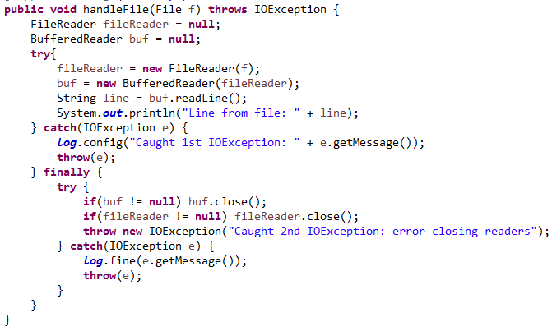
W2D4 : The Closing Resources Problem
Example: Consider this code (lesson10.lecture.trickycatch1):

Slide 9
W2D4 : The Closing Resources Problem (continued)
Some Problems with the Code.
First problem. It's messy and it's easy to implement it incorrectly.
More serious problem. Consider this scenario:
  After BufferedReader object is created, a call to readLine causes an IOException to be thrown.
  In the finally clause, an attempt is made to close the BufferedReader, but the close() operation also throws an IOException.
  Only one exception can be thrown, and the way Java does it is to throw the close operation exception (the one that we don't care about).
  In the demo code, the message displayed will be “Caught 2nd IOException: error closing reader.” The IOException indicating a failure to execute readLine() is lost.
.
Demo: lesson10.lecture.trickycatch1.MyClass2

Slide 10
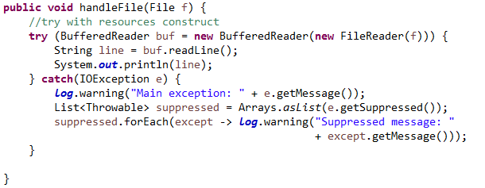
W2D4 : The Try-with-Resources Solution
Here is the Java 8 alternative to the previously displayed code:
Demo: lesson10.lecture.trickycatch4_trywithres.MyClass

Slide 11
The try-with-resources Solution (cont.)
Notes
The resources named in the "try" clause – in this case, a BufferedReader – will be closed at the completion of the try block.
If an exception is thrown during execution of try and an error occurs in closing these resources, the close exceptions will automatically be appended to the main exception as suppressed exceptions.
If no main exception occurs, but a close exception occurs, the close exception is thrown in the usual way.
It is now possible to read the suppressed exceptions using the getSuppressed() method, which returns a list of Throwables. These can be read and handled if desired, but the main exception is the one that is thrown and caught.

Slide 12
Exercise 10.3 - Optional
Use the try-with-resources construct to rewrite the class OldFileIO, which reads a file word_test.txt using pre-Java 8 approach. The necessary files are in the InClassExercises project, in the lesson10.exercise_3 package. Do the following:
Include a catch clause to catch the primary IOException if there is one.
In your catch clause, loop through and print any suppressed exceptions that may be thrown (as in the slides)
Notice how the file word_test.txt is accessed in OldFileIO (see FILE_LOCATION constant). Should this be improved? How?

Slide 13
W2D4 : More About Resources
A resource is an object that must be closed after the program is finished with it. The try-with-resources statement ensures that each resource is closed at the end of the statement.
Another example of a resource that can be managed with try-with-resources is the Connection object, invoked in interacting with a database, using JDBC. Handling exceptions and closing the connection in the right way and in the right sequence has tended to be error-prone. Using try-with-resources, it is straightforward to write code in the correct way.
See Demo lesson10.lecture.jdbc.read_trywithres. To run the code, you need to set up JavaDB. To do this, see setup/setting-up-javadb

Slide 14
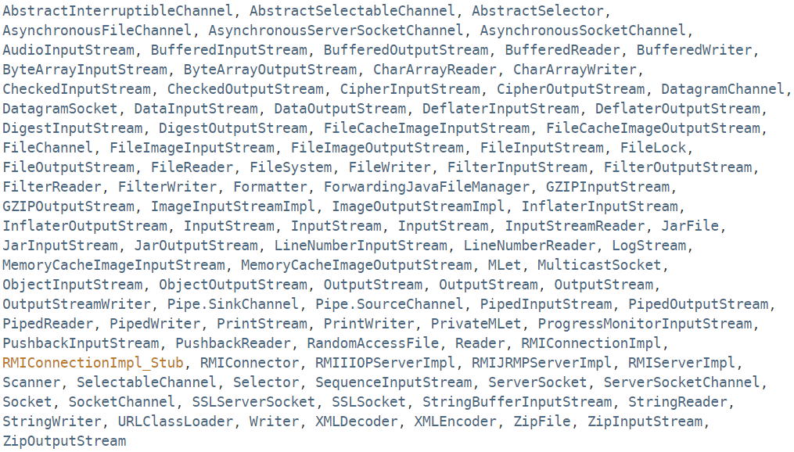
W2D4: Resources in Java 8 Which Can Be Used with try-with-resources
Any object that implements java.lang.AutoCloseable, which includes all objects that implement java.io.Closeable, can be used as a resource. The classes in Java 8 that implement AutoCloseable are listed here:

Slide 15
W2D4 - Main Point 1
Java's new try-with-resources construct handles the complex logic behind exception-handling when the process requires that a resource be "closed" after its use. Earlier versions of Java required developers to handle this situation with an error-prone imperative programming style; Java's new approach is declarative: The developer just tells the runtime which resources will be used and the runtime takes care of the close operations, including exception-handling. This effortless approach to handling code has a parallel in the domain of human life: When individual awareness is sufficiently attuned to the deeper levels of consciousness, less effort is required to achieve significant success.

Slide 16
W4D1 : Concurrent Processing and Parallel Streams - Overview
Introduction to threads
Working with threads: the Runnable interface
Thread safety and the synchronized keyword
Java 8 convenience class for invoking threads: the Executor class
When should you use parallel streams?

Slide 17
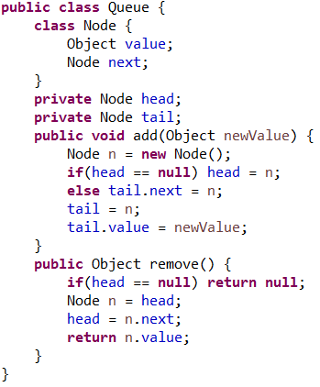
Exercise 10.4
The code to the right is an implementation of the Queue data type. Are its operations threadsafe? If not, think of a test you could do, involving multiple threads, that would prove that it is not. (You do not need to write any code, but you will in the lab, so you will be able to use the ideas you come up with now.)

Slide 18
Exercise 10.4 Solution
Multi-threaded access of Queue can lead to any of the following inconsistent states:
Can force the queue to have fewer than the net number of adds
Can force the queue to have more than the net number of adds
Can force the remove operation to generate a NullPointerException by trying to access a next node from a node that is already null.
See the document Lesson 10 - Vulnerabilities in the Queue Implementation

Slide 19
W4D1 (Do This) - Main Point
Code that will perform flawlessly in a single-threaded environment may bring disastrous consequences in a multi-threaded environment if shared data is not managed properly.
In life, a similar situation exists because the particulars of life are always changing. In any domain of life – work, family, health, society – a situation that appears favorable today may become unfavorable tomorrow. How does one prepare for change that cannot be predicted? The only way is to be established in a part of oneself that does not change, no matter how the world changes. That part is first experienced as simple silence in the practice of TM. In time, with regular practice, it becomes firmly established.

